Slide 1
2020 sGSL Snow Crab Stock Assessment: A review of recent survey issues
Southern Gulf of St Lawrence
DFO Regional Assessment Process, Feb 2021
Notes:
Thanks for the introduction,
The sGSL snow crab survey plays a central role for this assessment.
It allows us to position the stock status with respect to its reference points
It allows for prediction of fishing recruitment in coming years
The TAC for the sGSL is set as a function of the biomass index, which is directly estimated from survey data.
The introduction of a new survey vessel change 2019 was accompanied with a large and unexplainable increases in crab abundance, leading to never-before seen levels of crab catches on-board the survey vessel.
To be clear, these increases could not be explained via normal population processes, such as recruitment, lower mortality or skip-moulting, as the increases were very strong and spread out across a wide range of sizes.
This led to a thorough investigation into possible sources for these increases.

Slide 2
Table of Contents:
Population indices
Size frequencies for 2018 and 2019
Passive phase trawling
Size frequencies for 2020
Comparative catch experiment for 2019
Commercial catch stability
Conclusions

Slide 3
1. Population Indices:
Good measures of abundance or biomass allows for meaningful comparisons of population levels between different regions and/or from one year to the next.
Factors which systematically bias or skew catch observations need to be either controlled or otherwise accounted for.
Control of identified factors is achieved through the implementation of robust sampling protocols.
DFO Regional Assessment Process, 2020
Notes:
So what we mean by good abundance or biomass indices is that, for example:
If the population increases by say, 30%, then the abundance or biomass index, i.e. what we measure, also increases by 30%.
In other words, we want a fixed relationship between our the indices that we measure, and the underlying true abundance of the population.
Examples of controlled factors:
Vessel speed.
Tow duration (5 minutes).
5-minute tow duration
Gear dimensions & configuration.
Time of day
These controlled factors aims to maintain the consistency of trawl behavior between different tows.

Slide 4
1. Population Indices:
Uncontrolled factors need to be identified, quantified or otherwise accounted for, in order to standardize catches.
Failure to account for influential factors can lead to indices with misleading regional or annual changes, reflecting changes in the factors themselves rather than true changes in population abundance or biomass.
DFO Regional Assessment Process, 2020
Notes:
Examples of factors uncontrolled, but accounted for:
As an example of a quantified factor, trawl width measurements during trawling are made to estimate the total area swept by each trawl of the survey, which shows a lot of variation from tow to tow, through variations in trawl width, touchdown and stop times. This is a quantitative measure of fishing effort and is currently the only factor used to standardize survey catches.
In particular, failing to account for uncontrolled factors leads to biased abundance and biomass indices, which impact:
mortality estimates
exploitation rates
Biomass index issues = TAC issues,

Slide 5
2. Size-frequencies: 2018 versus 2019
Males
Increase of 30-40% over sizes 35-95mm in 2019.
Little change for larger crab (>= 95mm).
Large increases for first 2 visible instars (<25mm).
Notes:
So in this figure, we compare the catches for male snow crab in 2018 and 2019.
Panel above shows the size-distribution of male snow crab for the 2018 (top panel) and 2019 surveys (bottom panel).
For 2018, the green bars are immature crab and mature crab are shown in blue.
The vertical dashed red line is the 95mm legal size.
The bottom panel shows the size distribution for 2019, with light grey bars indicating immature crab this time, and dark grey bars indicating mature crab.
The levels for 2018 were superimposed as green and blue lines.
This immediately shows that the strength of the increase is on the order of 30-40% among males from 35-95mm.
Why this raises some red flags, is that such large increases across such a wide size range are unexplainable using normal population processes:
Recruitment occurs at small sizes, not spontaneously in larger sizes
Even setting zero mortality does nothing to explain increases.
Migration on this scale is extremely unlikely in the sGSL.
Where we saw a break from this pattern:
Small crab < 35 mm CW, but:
are highly variable:
Incoming recruitment
Low trawl catchability and selectivity, subject to localized effects.
Commercial sized males
Very little change observed … which raises questions as to why no increases were observed.

Slide 6
2. Size-frequencies: 2018 versus 2019
Females
Same pattern as sub-legal males:
Large increases for first 2 visible instars (<25mm).
Increase ~40% among immature and mature females.
Notes:
Same pattern as sub-legal males.

Slide 7
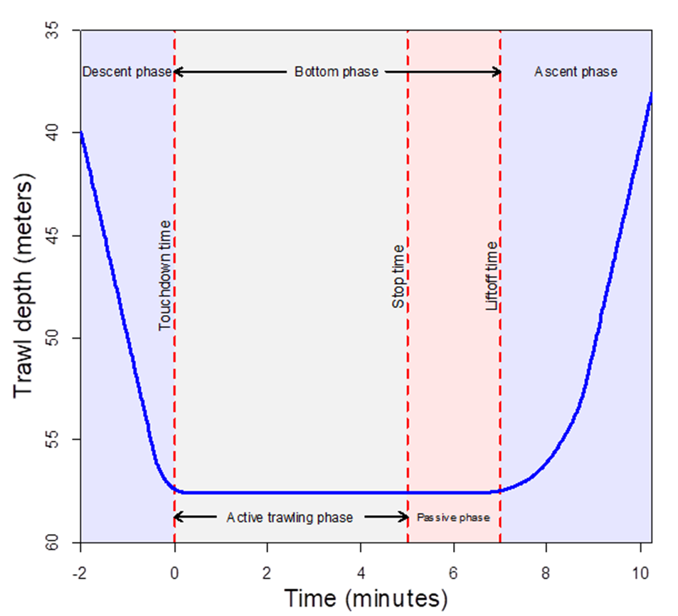
3. Passive trawling phase update:
Notes:
This a graphical representation of the different events and phases related to trawling:
The blue line indicates the depth of the trawl as a function of time.
The events are shown as vertical red dashed lines
Touchdown time
Stop time (triggers vessel deceleration, winch activation and end-of-tow vessel manoeuvres)
Lift off time, when the trawl lifts off the bottom.
These events are used divide trawling into distinct phases:
Trawl descent and ascent phases (lighter shade of blue).
Active trawling phase (grey)
Passive trawling phase (shaded red).
So during this passive trawling phase:
The winch is activated, but it takes a fair amount of time for the trawl to lift off the bottom
And the trawl continues to be dragged, by a combination of vessel movement and winch action.
The passive trawling phase is not currently accounted for in our swept area calculations.

Slide 8
3. Passive trawling phase recap:
Variable | 2017 | 2018 | 2019
Swept area (active phase) | 2815 m² | 2769 m² | 2751 m²
Tow duration (active phase) | 313s | 310s | 307s
Haul time | 218s | - | 254s
Passive phase duration | 82s | 75s | 116s
Passive phase swept area | 1014 m² | 938 m² | 1270 m²
Slower winch operation in 2019
Vessel kept its forward heading.
Moderate vessel deceleration.
Estimates of passive phase swept areas suggest that they are a large source of unaccounted bias.
Notes:
Here we have a table of trawl summary statistics from 2017 to 2019.
The mean trawl swept area for the active phase is very comparable between years at 2751 to 2815 m2.
Duration of the active phase is similarly comparable at a little over 5mins, which is the target tow duration.
The average time required to haul the trawl doors to the water surface increased by about 30s in 2019 (I had some problems calculating the haul time for 2018)
In contrast, the duration of the passive trawling phase increased substantially in 2019, from about 80s to 116s.
Using a number of assumptions, swept area estimates were calculated for the passive phase, which gave substantial values of 1014 (2017), 938 (2018) and an increase to 1270m2 in 2018
The scale of these passive phase swept area estimates are a major cause for concern, as they are not used for standardizing survey catches, and represent a potential 30-40% positive bias in population indices.
However, the issue here was mainly one of a lack of control:
Vessel speed, vessel manoeuvers and winch speed all contribute to varying the extent of the passive trawling phase between years.
The fishing efficiency of the trawl over this period varies much more than the much better controlled active trawling phase.
In particular, contact of the trawl doors during this period may be lessed
Leading to much lessened trawl width.
Footrope contact may be lessened
Thus, swept area of the passive may not directly translate into catches and may represent some fraction of what its swept area suggests.

Slide 9
3. Protocol changes for 2020:
At the end of tow:
Increase winch speed to 2017 and 2018 levels.
Stronger vessel deceleration.
Turn vessel while winching.

Slide 10
3. Survey vessel speed: end of tow
Notes:
This graph compares survey vessel speed profiles at the end of active trawling for 2017 to 2020.

Slide 11
3. Survey Vessel Tracks: 2017-2020
Notes:
Longer tracks correspond to tows along the Laurentian channel
Center point shows the start of each tow.
Grey line segments show the vessel movement during active trawling
Red line segments on the periphery show the survey vessel’s movement during the passive trawling phase.
Years 2017, 2018 and 2019 show that the vessel generally kept a straight heading at the end of the tow, but that the extent of the passive trawling was much increased in 2019, indicated by longer red line segments in 2019.
Dashed circle is the 300 meter line, showing that tows are typically around 330-350 meters or so.

Slide 12
3. 2020 Survey Summary:
Variable | 2017 | 2018 | 2019 | 2020
Swept area (active phase) | 2815 m² | 2769 m² | 2751 m² | 2637 m²
Tow duration (active phase) | 313s | 310s | 307s | 301s
Haul time | 218s | - | 254s | 216s
Passive phase duration | 82s | 75s | 116s | 130s
Passive phase swept area | 1014 m² | 938 m² | 1270 m² | -
These results for 2020 are counterintuitive:
Haul times are short – therefore winch is faster.
…but passive phase duration has increased to 130s.

Slide 13
3. Passive phase duration increase:
Upward force acting on the trawl doors is a function of:
Tension of the warp cables acting on the doors.
Steepness of the angle between the cables and the bottom.
While the contribution of the winch to the cable tension has increased in 2020, the amount of force exerted by the survey vessel has decreased. Therefore:
The trawl and the vessel must be closer together before lifting off, i.e. the angle must be steeper.
It’s unfortunately not clear whether the distance that the trawl travelled during the passive phase in 2020 has decreased.
Notes:
So what can we say about the extent of the passive phase in 2020?
The vessel is not hauling the trawl as much, BUT the trawl now needs to drawn closer to the vessel before lifting off …
It’s unfortunately not clear if the distance that the trawl travels during the passive phase has changed … it may be possible to calculate, but requires considerations in 3-dimensions rather than 2d, as was done last year, because the vessel is now manoeuvering around the trawl.

Slide 14
4. Size-frequencies in 2020:
Males
Catches in 2020 are very comparable to 2019, i.e. little scale reduction associated with the new end-of-tow procedures.
Large increase in instar VII crab in 2020.
Size-distribution among legal-sized crab is very similar between the 2018, 2019 and 2020.

Slide 15
4. Size-frequencies in 2020:
Females
As for males, female catches for 2020 are very comparable to 2019
Large increase in instar VII crab in 2020.

Slide 16
How do the 2019 comparative fishing experiment results fit into the catchability discussion?
5. Question:

Slide 17
5. 2019 Comparative fishing experiment:
Experiment:
Side-by-side fishing.
Final 40 stations of the survey.
Area west of Cape Breton.
Results:
Analysis showed that catches for male and immature females were comparable between the two vessels.
Catches of mature females were larger in the previous vessel.
This contradicts the 2018-2019 trend in the remainder of the survey… so what’s going on?

Slide 18
5. Survey Catch increases in 2019 versus 2018:
Ratio of the number of sub-legal males larger than 35mm CW caught in 2019 versus 2018 snow crab surveys. Increases are red, decreases are blue, and white indicates no change. Survey grids containing less than 10 crab were shrunk as a function of sample size.

Slide 19
5. Survey Catch increases in 2019 versus 2018:
Ratio of the number of mature females caught in 2019 versus 2018 snow crab surveys. Increases are red, decreases are blue, and white indicates no change. Survey grids containing less than 10 crab were shrunk as a function of sample size.

Slide 20
5. Survey Catch increases in 2019 versus 2018:
Ratio of the number of legal-sized males larger than 35mm CW caught in 2019 versus 2018 snow crab surveys. Increases are red, decreases are blue, and white indicates no change. Survey grids containing less than 10 crab were shrunk as a function of sample size.

Slide 21
5. 2019 Comparative fishing experiment:
Catch increases in sub-legal males and mature females are widespread throughout the sGSL, but are more concentrated in certain areas.
The pattern for legal-sized males is much more varied.
Comparative fishing stations were not located in areas where large catch increases were observed, and so experiment did not reflect changes observed in the rest of the survey.
Increases in catchability may vary by bottom type.

Slide 22
Why has the legal-sized male abundance remained so stable between 2018-2020, given the seeming increase in catchability among sub-legals and females?
6. Question:

Slide 23
6. Discussion:
There are a few hypotheses regarding legal-sized male abundance not following the sub-legal increase in 2019:
Catchability increase is present among sub-legal crab sizes only.
… but why would there be a 30-40% contrast in the relative catchability between 80-90mm crab and their legal-sized counterparts?
Significant increase in mortality among legal-sized males in 2019 and 2020, relative to 2018.
Are large-scale spatial redistributions of fleet fishing effort leading to large increases in discard mortality?
Catchability increases are local effects that tend to coincide with regions with high intermediate 35-95mm crab abundance, but less so for legal-size males.
Notes:
I would consider the first hypothesis to be unlikely, at least … any such catch mechanism would not likely drop off as dramatically as what is observed between the 90 mm and 100mm, though softer size-dependent variation is possible, but we generally expect larger crab to be more catchable as a general rule.
The second hypothesis suppose that a substantial increase in legal-sized mortality occurred in 2019 relative to that of 2018, and that it was sustained in 2020.
This increase would have to be substantial to explain the apparent 30-40% increase difference between the sub-legals and legals.
A third hypothesis explores the idea that year-on-year increases in catchability varied regionally.
Oddly, this idea has some traction in that catchability increases over the center of the gulf and area 12F may have been counterbalanced by decreases in Area 19 and the re-opened Shediac Valley in 2019.
2020 saw decreases in the central Gulf and increases in Area 12F and 19 as well as the Baie des Chaleurs.
It is in the realm of possibility that these apparent spatial dynamics between these years acted in such a way as to yield the comparable commercial levels observed in the 2018-2020 size-frequencies.

Slide 24
7. Conclusions:
Protocol changes seeking to control the passive trawling phase in 2020 did not diminish the duration of the phase with respect to 2019.
2019 and 2020 size-distributions were strikingly similar, except for a large recruitment increase of instar VII (~30mm) and a slight decrease among sub-legals.
The lack of dynamics among legal-sized males from 2018 to 2020 is perplexing. Explaining this apparent stability requires resolution between the competing hypotheses of constant catchability, strong increase in mortality from 2018 to 2019, or spatial catchability increases which have tended to occur over female and sub-legal male crab, but less so over legal-sized male crab.
The survey time series is inconsistent, at least for sub-legal males and mature females, at the juncture of the vessel change in 2019.
Predicted recruitment levels for 2020 and 2021 are likely to be inflated, and risk curves are likely underestimate the stated exceedance probabilities.

